Slide 1


Slide 2
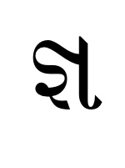
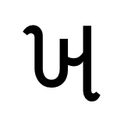
Character Recognition
For unknown language character or symbol can be trained using deep learning to recognize it for different purpose
It can be also used to recognize the numbers for application such as number plate recognition etc.

Slide 3
Block Diagram – Workflow of Image Classification CNN
Dataset Creation
Train, Test, Val
CNN Design
Pre-Processing
Training - Model
Load Model - Test
Pre-process Input Image
Classification

Slide 4
! BONUS !
Installing Libraries
PyQt5: pip install PyQt5

Slide 5
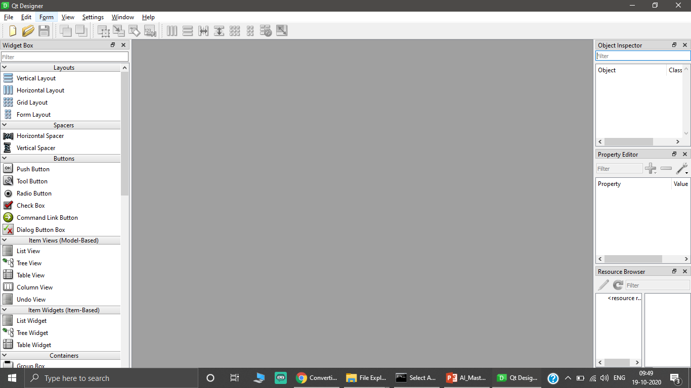
! BONUS !
PyQt Designer

Slide 6
Designer to Python Program
python -m PyQt5.uic.pyuic -x [FILENAME].ui -o [FILENAME].py

Slide 7

Ready For Hands On
Character Recognition using Deep Learning

Slide 8




THANK YOU☺
NOVITECH COIMBATORE
novitechresearchanddevelopment

Slide 9
Q & A Session?

